Slide 1

Go play with sorting algorithms here (use the one step at a time, look at the code!)
https://visualgo.net/en/sorting

Slide 2
cs50 section 3
Algorithms
Andrew Holmes 2023

Slide 3
Today’s plan
01
Structs
03
Recursion
02
Sorting Algorithms
04
PSET
Organizing data!
Spooooky…
The fun stuff!
Looking ahead!

Slide 4
01
Structs
Organizing data!

Slide 5
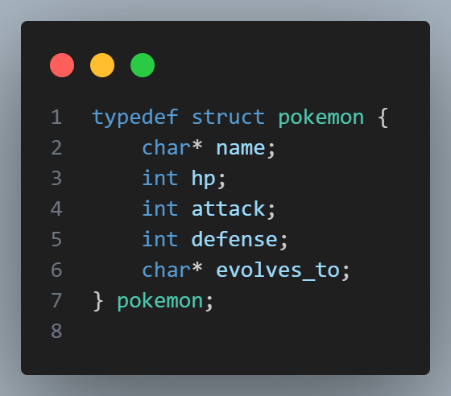
Defining a struct
Structs
Typedef – creates pokemon as a type!
Must give types and names of struct attributes.

Slide 6
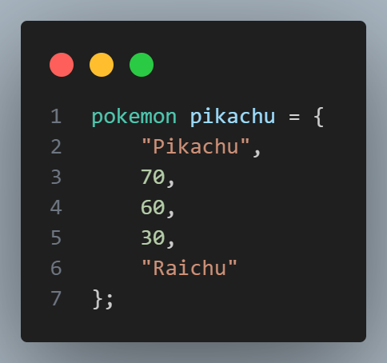
Initializing a struct
Structs

Slide 7
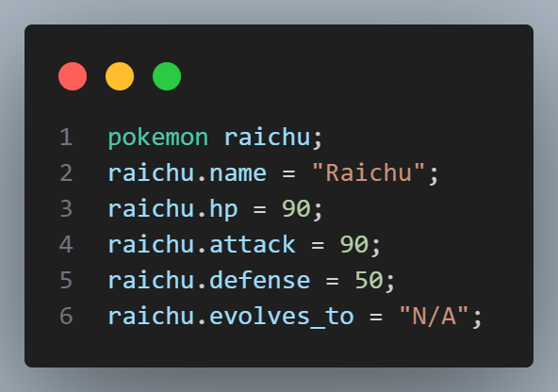
Initializing a struct
Structs
A better way to do this, so it’s clear what each data corresponds to.

Slide 8
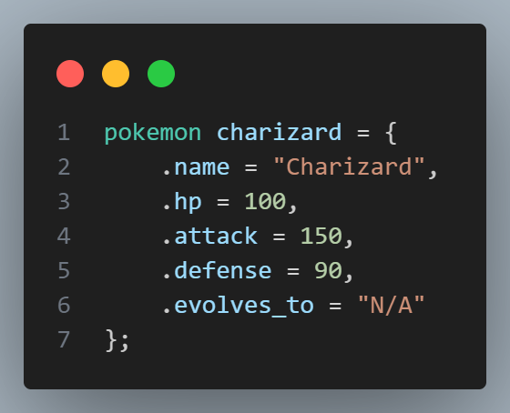

Initializing a struct
Structs
Just do it in one go, the best way, duh

Slide 9
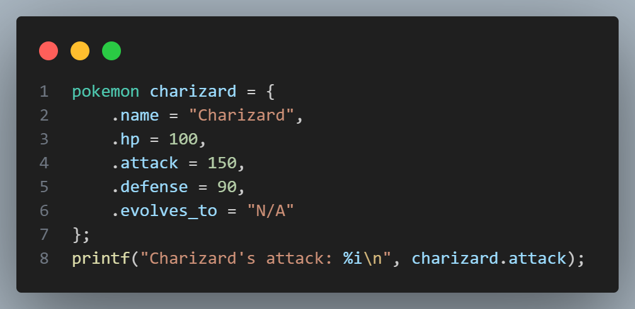
Accessing a struct
Structs
Structs use .attribute to access different parts of the struct

Slide 10
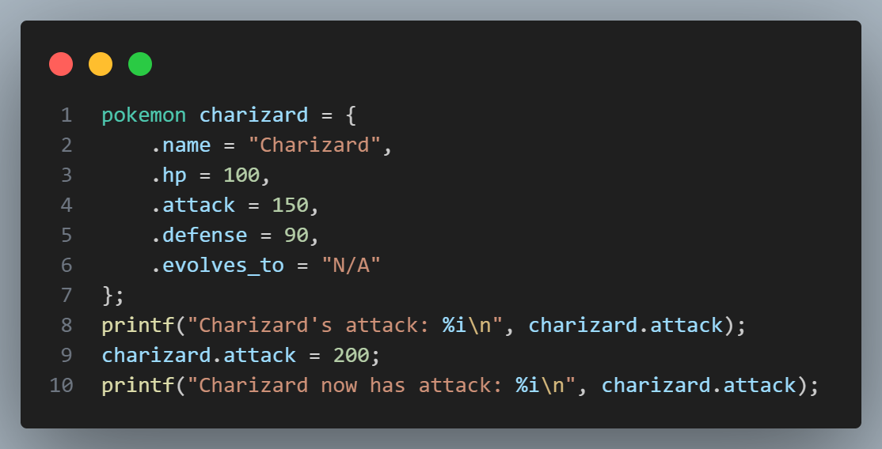
Assigning to a struct
Structs
Behaves like a normal variable!

Slide 11
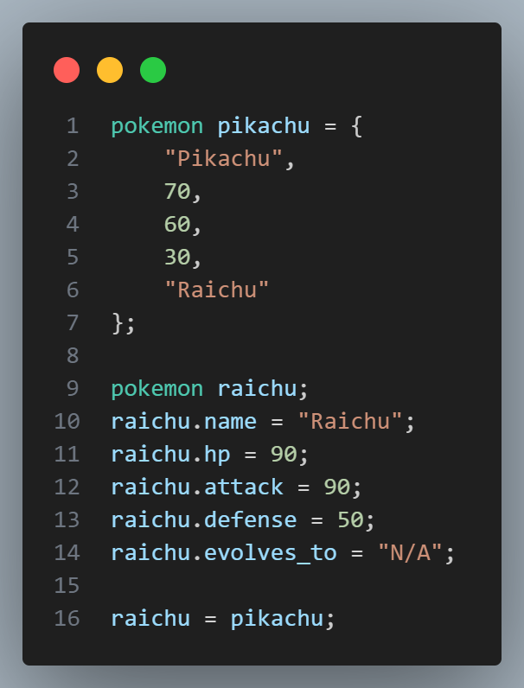
Assigning to a struct
Structs
You can also assign entire structs just as if they were any other type! This means when sorting or moving pixels (with RGB values), you can just work with the entire struct…

Slide 12
Struct layout investigation
Structs
Q: What do you think the size of this struct is? Try it yourself: create this struct, and use C’s sizeof function to find out! Why do you think that might be?

Slide 13
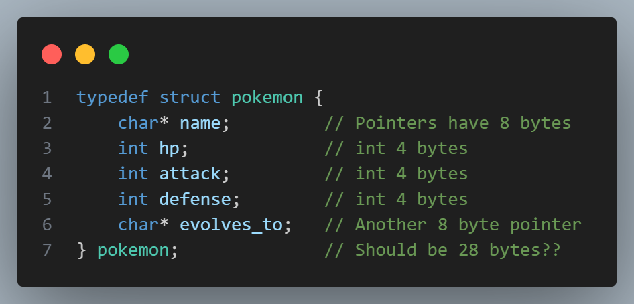
Struct layout investigation
Structs

Slide 14
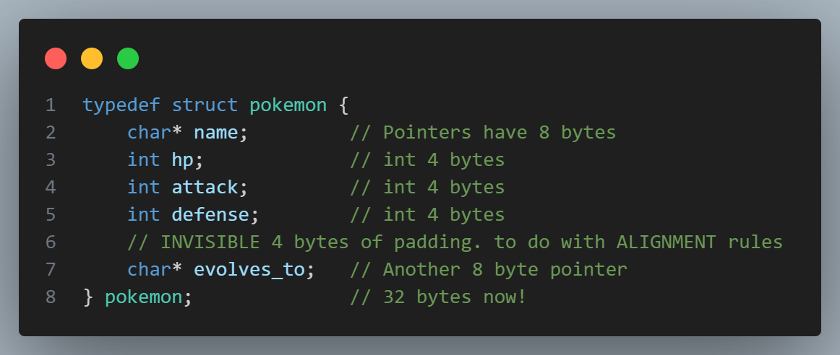
Struct layout investigation
Structs

Slide 15
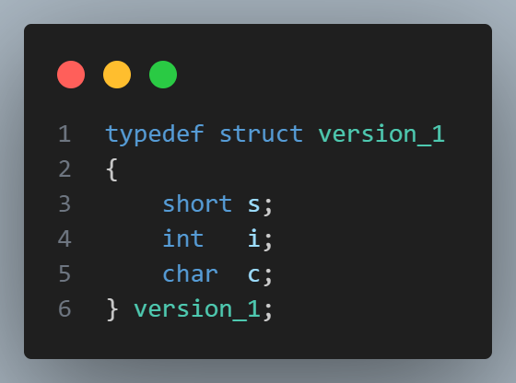
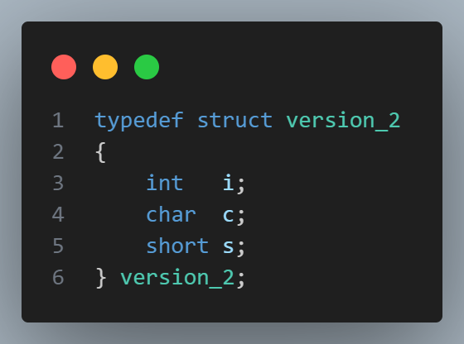
Struct layout investigation
Structs
Q: Are these two the same size?

Slide 16
02
Sorting Algorithms
Sorting and searching.

Slide 17

Motivation: why sort?
Sorting
Let’s consider searching! Let’s try to find 7:

Slide 18

Motivation: why sort?
1
8
3
Sorting
Now we have a sorted list. Even if we keep our linear search, we might have a new idea as to which end to start, or to try a place to start looking from.

Slide 19
Binary Search
Sorting
Can’t be here
Can’t be here
4 is less than 7, so if sorted, must be to the right!
There’s 7!
6 is less than 7, so if sorted, must be to the right!

Slide 20
Binary Search
Sorting
Can’t be here
Can’t be here
4 is less than 7, so if sorted, must be to the right!
There’s 7!
6 is less than 7, so if sorted, must be to the right!

Slide 21
Motivation: sorting
Sorting
So sorting can help us speed up finding data!

Slide 22

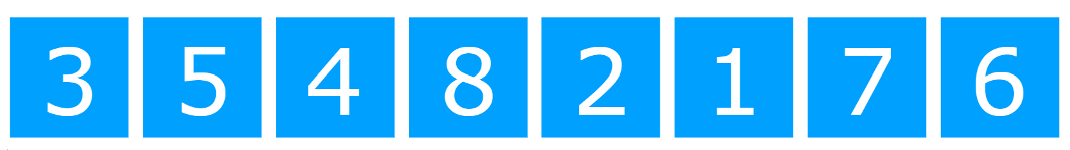
Bubble Sort
Sorting
Wrong order!
But more still to do!
Make swap – now correct order!

Slide 23
Bubble Sort
Sorting
Let’s look at bubble.c to see how I implemented bubble sort.

Slide 24
Bubble sort thoughts: too many swaps, have to swap each number many times. Let’s just swap directly to the right position!
Selection Sort!

Slide 25


Selection Sort
Sorting
Min element
Min element
Min element

Slide 26

Selection Sort
Sorting
Etc…

Slide 27




Arrays
In pairs, tackle ‘temps’:
Sort the cities by average temperature to practice a sorting algo + structs.
See Slack for instruction file.
Practice!

Slide 28
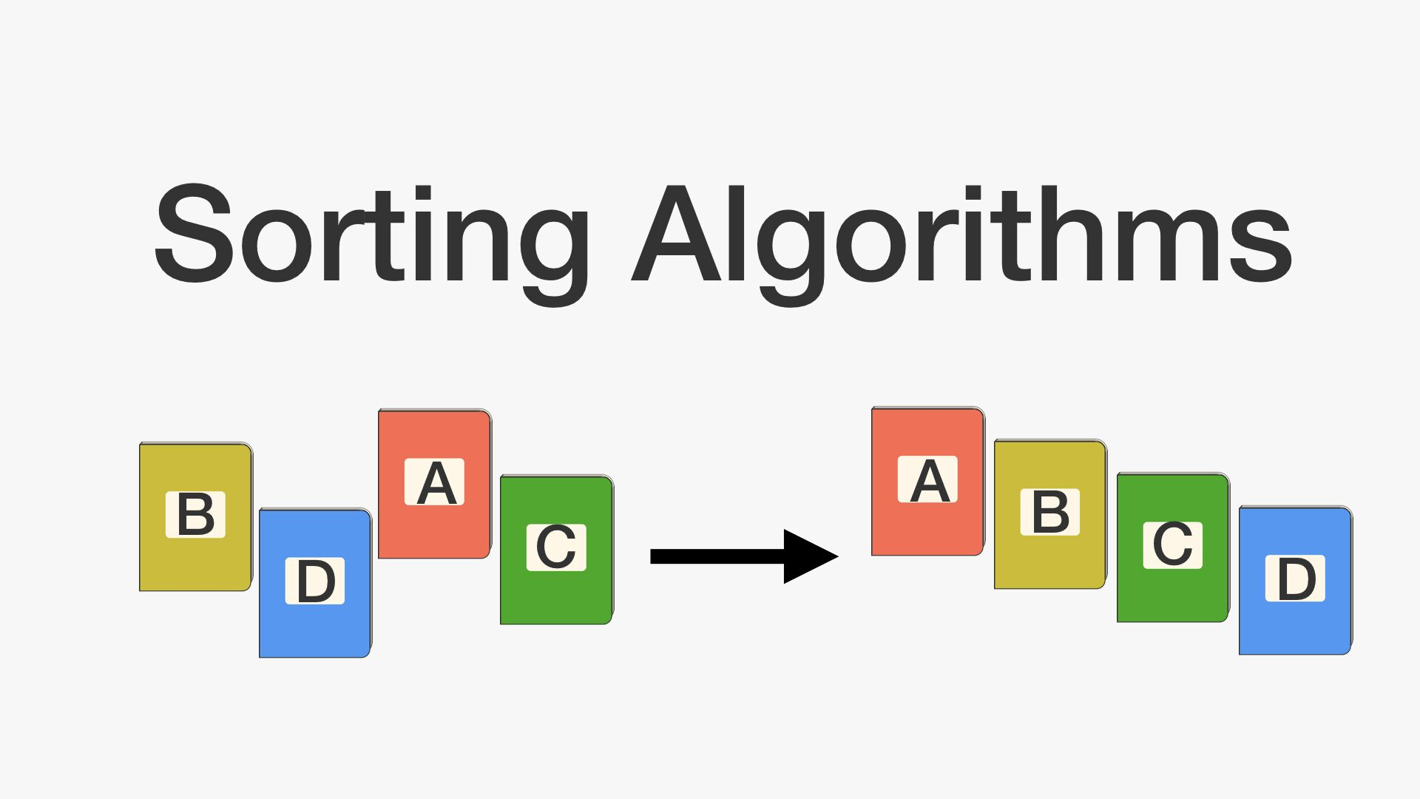
Sorting
Implement selection sort in selection.c (see Slack)
Practice!

Slide 29
Merge Sort
Sorting

Slide 30
Sorting
Let’s tackle the sort problem set from PSET 3 together!
Practice!

Slide 31
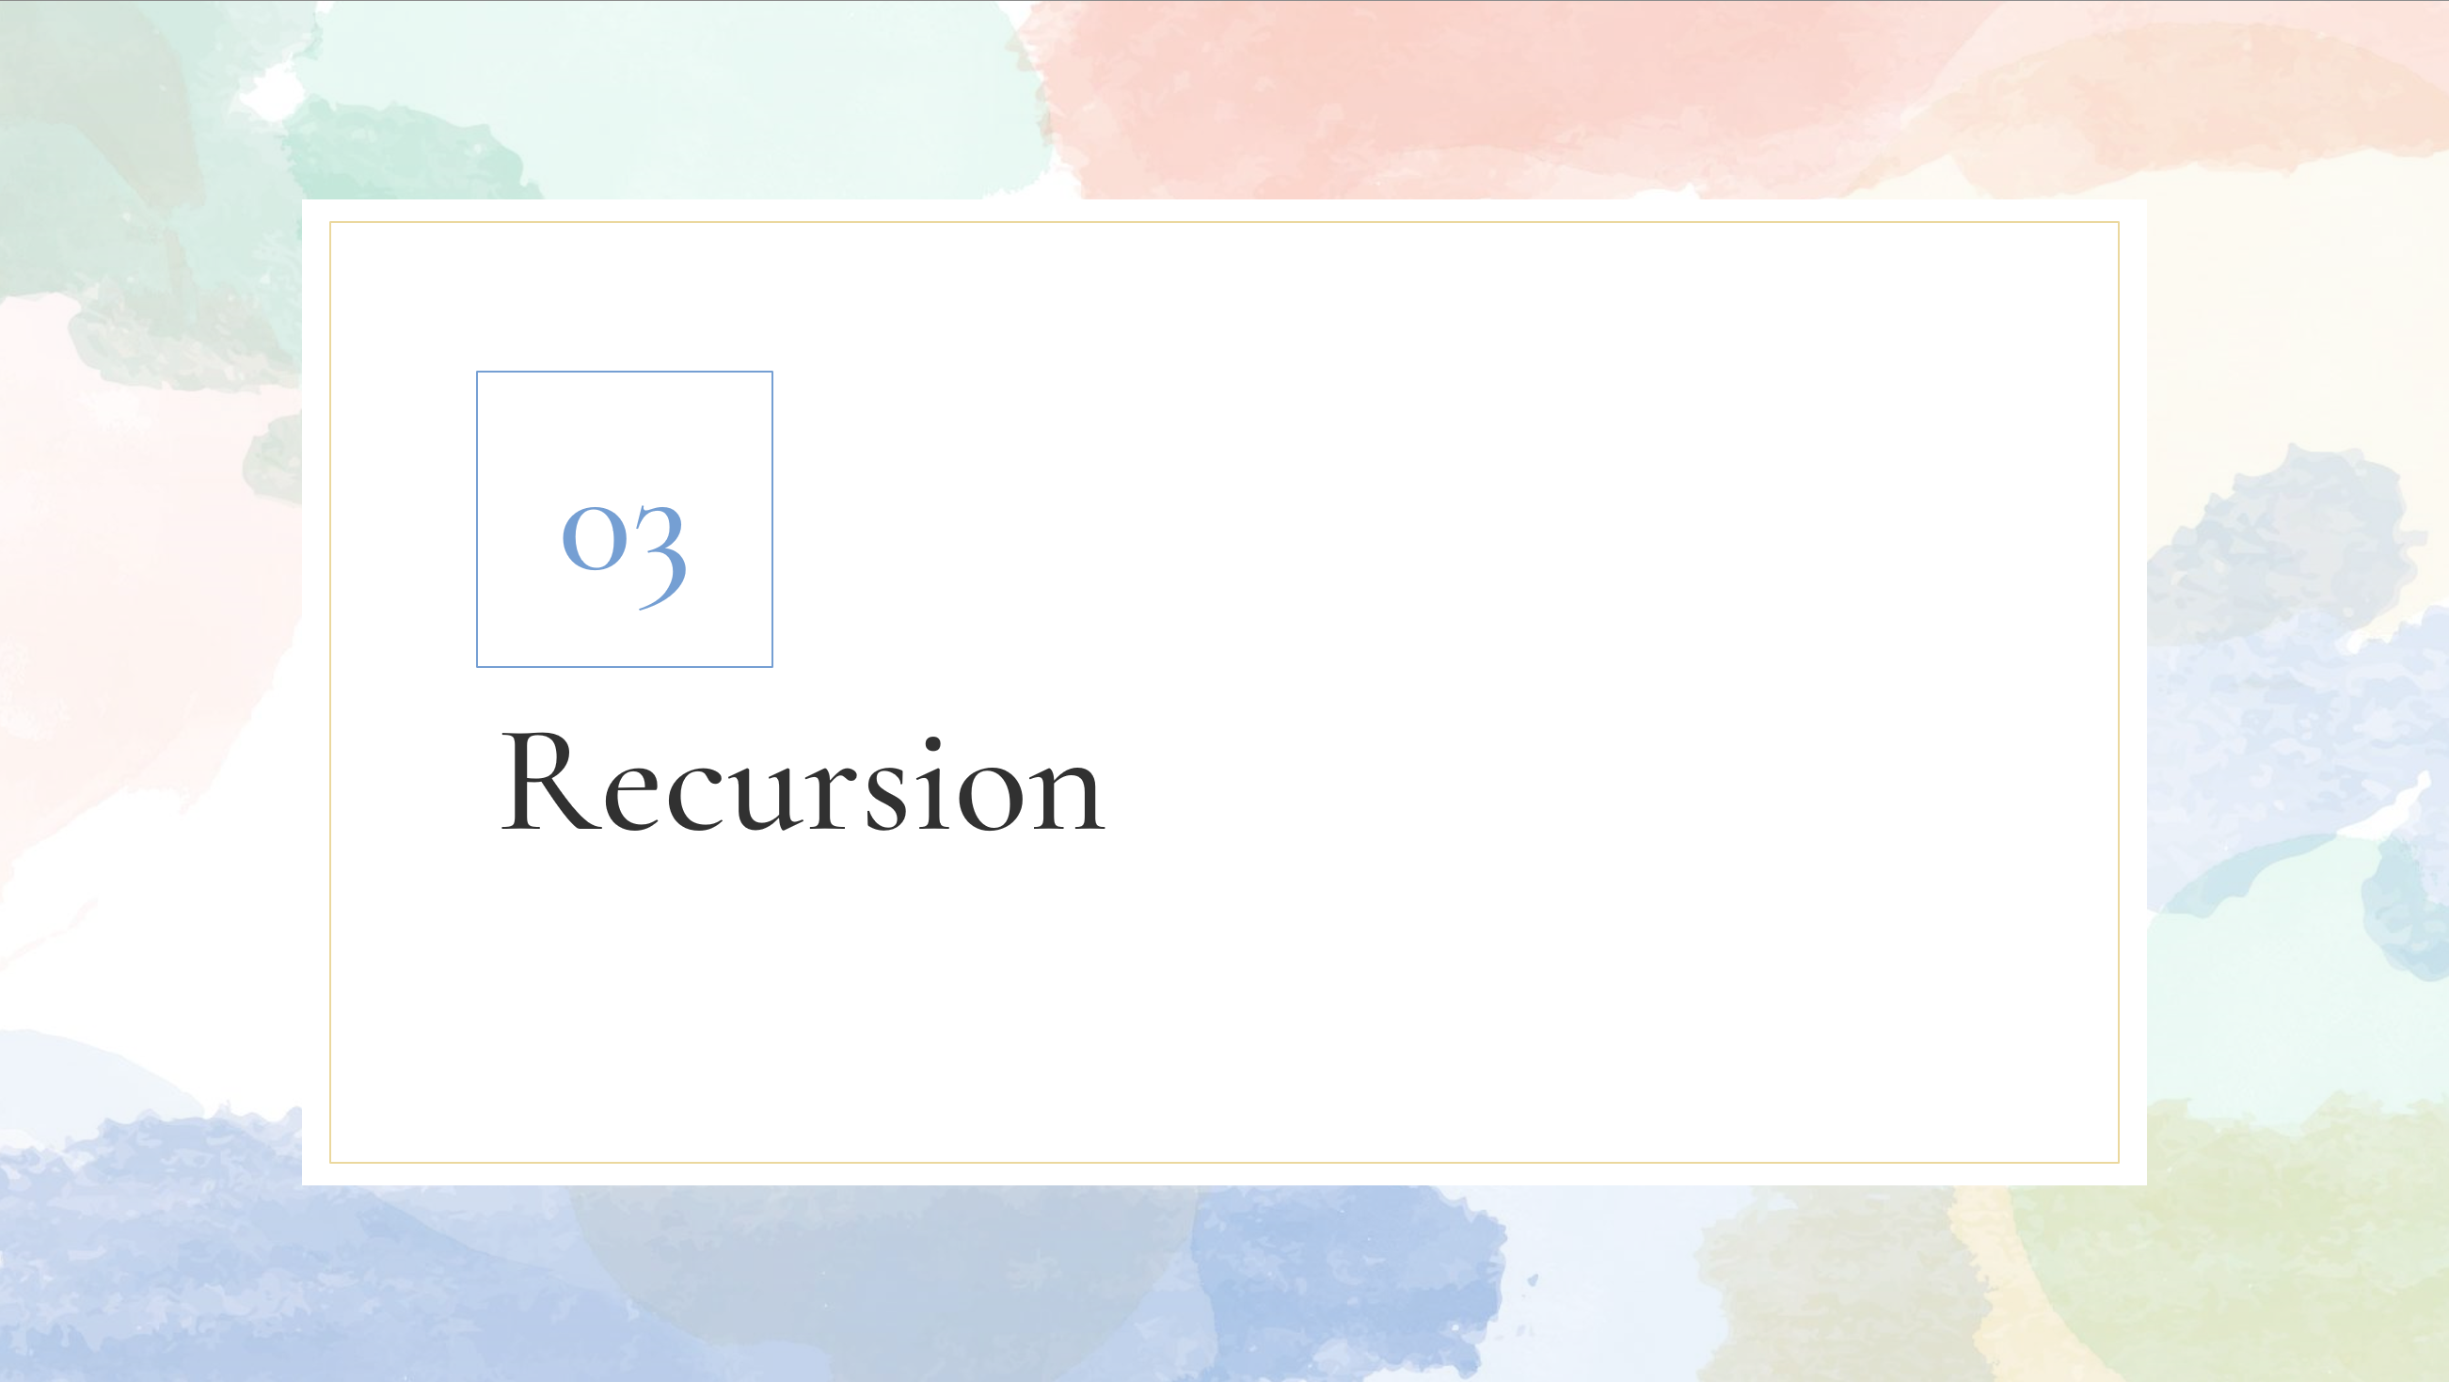
03
Recursion

Slide 32
The classic example
Recursion
5! = 5 * 4!
5! = 5 * (4 * 3 * 2 * 1)

Slide 33
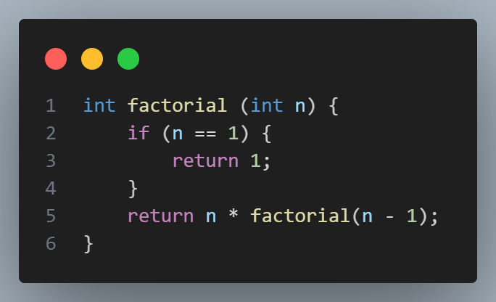
The classic example
Recursion

Slide 34
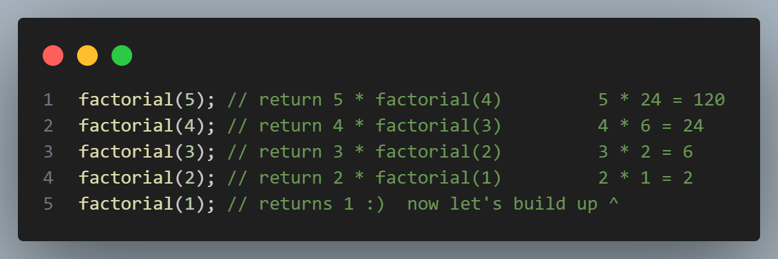
Walking through factorial
Recursion
Recursion

Slide 35
Key parts of recursive functions
Recursion
BASE CASE: something to stop recursing forever!
Recursive part: something to recurse sometimes!

Slide 36
Depth-First Search
Recursion
Let’s imagine we wanted to check if the number 4 was in this tree…
1
7
9
4
0
4
8

Slide 37
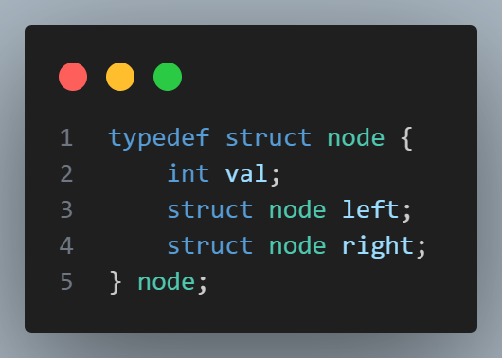
Quiz!
Recursion
Is this a good way of representing the previous problem? Discuss!

Slide 38
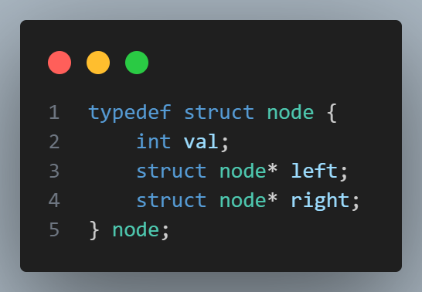
Pointers!
Recursion
We can’t store structs within structs! But we can store address to other structs to allow us to link them together!

Slide 39
tree_search.c
Recursion, pointers & structs demo!

Slide 40
Things to think about from tree_search.c
Recursion
Where were the base cases in my functions?
Was there a pattern? Did base cases come first? Last? Doesn’t matter?

Slide 41
Things to take from tree_search.c
Recursion
Recursion actually incredibly useful!
malloc to allocate memory that doesn’t die after function ends – memory on the HEAP.
Malloc’d memory must be free’d!
Pointers store address. Create using type*, you can access the underlying data using *variable.

Slide 42
04
PSET
Week ahead

Slide 43
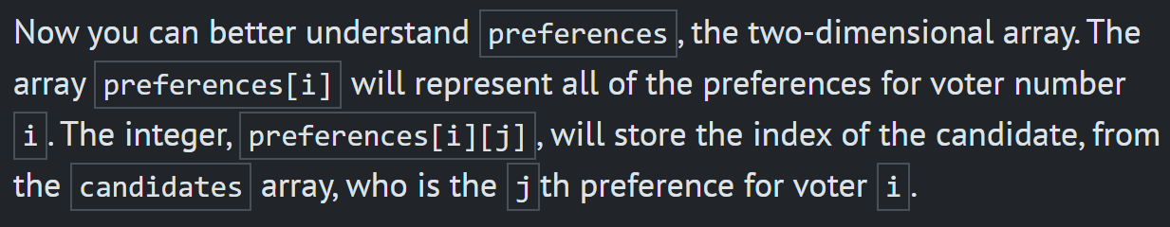
PSET info
PSET
Tideman is, in most people’s opinions, the largest jump from less comfortable to more comfortable PSET options. Be wary, it is tricky and will take some conceptual thinking. You guys can do it I’m sure, but be warned.
In Runoff, what does preferences[i][j] signify?

